Slide 1
Face Recognition via Adaptive Sparse Representations of Random Patches
Domingo Mery
Department of Computer Science
Universidad Católica de Chile
Kevin Bowyer
Department of Computer Science & Eng.
University of Notre Dame

Slide 2




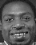


subject 1
subject i
subject k
. . . . . .
:
:
:
description
description
description
classifier’s design
LEARNING
TESTING
description
classification
ID
query image

Slide 3
subject 1
subject i
subject k
. . . . . .
:
:
:
description
description
description
classifier’s design
LEARNING
TESTING
description
classification
ID
query image

Slide 4
Are all parts of the face important?
Important for Mary.
Notes:
This problem gives rise to some interesting questions
This problem raises some interesting questions
Some interesting questions arise out of this problem

Slide 5
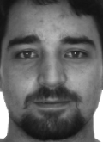
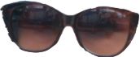
Are all parts of the face important?
Important for Mary and Miguel.
Not important at all.
Important for Miguel.
Notes:
This problem gives rise to some interesting questions
This problem raises some interesting questions
Some interesting questions arise out of this problem

Slide 6
Our approach uses Random Patches!
description
selection
classfication
ID
query image

Slide 7
Face Recognition via Adaptive Sparse Representations of Random Patches
Can random patches be used
to recognize any face?
Domingo Mery – Kevin Bowyer
Notes:
Can random patches be used to recognize any facial attribute?

Slide 8
Can random patches be used
to recognize any face?
Notes:
Can random patches be used to recognize any facial attribute?

Slide 9
Can random patches be used
to recognize any face?
Face Recognition
Mary Smith

Slide 10
Can random patches be used
to recognize any face?
Face Recognition
Miguel García

Slide 11
Can random patches be used
to recognize any face?
Motivation
Method
Experiments
Conclusions

Slide 12
Method - Overview
subject 1
subject i
subject k
. . . . . .
:
:
:
description
description
description
classifier’s design
LEARNING
TESTING
description
classification
ID
query image

Slide 13
Method - Overview
subject 1
subject i
subject k
. . . . . .
:
:
:
description
description
description
dictionary 1
dictionary i
dictionary k
LEARNING
TESTING
description
sparse
representation
classification
ID
query image
Notes:
Sparse representations have been widely used in many computer vision problems such as face recognition.
We build a dictionary from the gallery images.
We reconstruct the query image using a sparse combination of the dictionary.
We recognize the subject by searching the minimal reconstruction error.

Slide 14
Method - Overview
subject 1
subject i
subject k
. . . . . .
:
:
:
description
description
description
dictionary 1
dictionary i
dictionary k
LEARNING
TESTING
description
SRC
ID
query image

Slide 15
Method - Overview
subject 1
subject i
subject k
. . . . . .
:
:
:
:
:
:
description
description
description
dictionary 1
dictionary i
dictionary k
LEARNING
TESTING
description
SRC
ID
query image

Slide 16
Method - Overview
subject 1
subject i
subject k
. . . . . .
:
:
:
:
:
:
description
description
description
dictionary 1
dictionary i
dictionary k
LEARNING
TESTING
description
SRC
ID
query image

Slide 17
Method - Overview
subject 1
subject i
subject k
. . . . . .
:
:
:
:
:
:
description
description
description
dictionary 1
dictionary i
dictionary k
LEARNING
TESTING
for each test patch
:
:
description
SRC
majority vote
query image
ID
for all test patches
Notes:
Huge dictionary
Sparse representation could be very time consuming

Slide 18
Method - Overview
subject 1
subject i
subject k
. . . . . .
:
:
:
:
:
:
description
description
description
dictionary 1
dictionary i
dictionary k
LEARNING
TESTING
for each test patch
:
:
description
selection
of best
dictionaries
SRC
majority vote
query image
ID
for all test patches

Slide 19
Method - Overview
subject 1
subject i
subject k
. . . . . .
:
:
:
:
:
:
description
description
description
dictionary 1
dictionary i
dictionary k
LEARNING
TESTING
for each test patch
:
:
description
selection
of best
dictionaries
SRC
score
majority vote
query image
ID
for all test patches

Slide 20
Method - Details
subject 1
subject i
subject k
. . . . . .
:
:
:
:
:
:
description
description
description
dictionary 1
dictionary i
dictionary k
LEARNING
TESTING
for each test patch
:
:
description
selection
of best
dictionaries
SRC
score
majority vote
query image
ID
for all test patches

Slide 21
Method - Details
subject 1
subject i
subject k
. . . . . .
:
:
:
:
:
:
description
description
description
dictionary 1
dictionary i
dictionary k
LEARNING
TESTING
for each test patch
:
:
description
selection
of best
dictionaries
SRC
score
majority vote
query image
ID
for all test patches

Slide 22
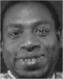
Method - Description
Description of
one patch
patch
x
f
y
description z
(x,y)
α x
α y
d = w²
w
w
location
2

Slide 23
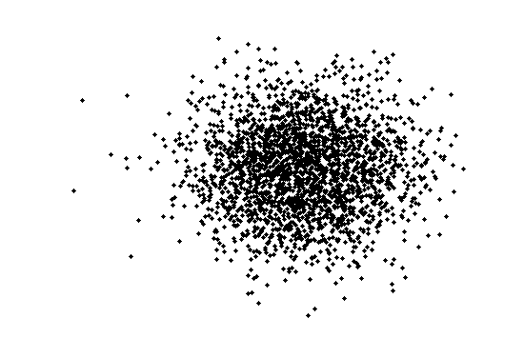
Method - Description
Description of
all patches
of subject i
Description of
one patch

Slide 24
Method - Details
subject 1
subject i
subject k
. . . . . .
:
:
:
:
:
:
description
description
description
dictionary 1
dictionary i
dictionary k
LEARNING
TESTING
for each test patch
:
:
description
selection
of best
dictionaries
SRC
score
majority vote
query image
ID
for all test patches

Slide 25
Method - Details
subject 1
subject i
subject k
. . . . . .
:
:
:
:
:
:
description
description
description
dictionary 1
dictionary i
dictionary k
LEARNING
TESTING
for each test patch
:
:
description
selection
of best
dictionaries
SRC
score
majority vote
query image
subject
for all test patches

Slide 26
Method - Dictionaries
Description of
all patches
of subject i
Description of
one patch

Slide 27
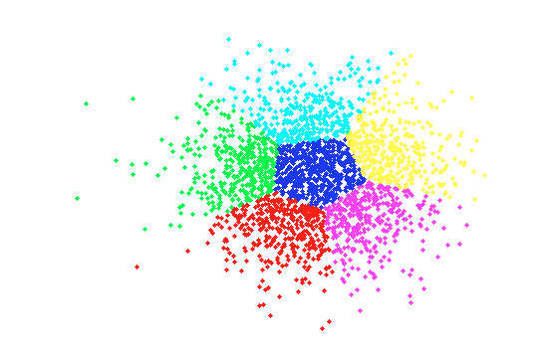
Method - Dictionaries
Description of
all patches
of subject i
K-Means with Q clusters

Slide 28
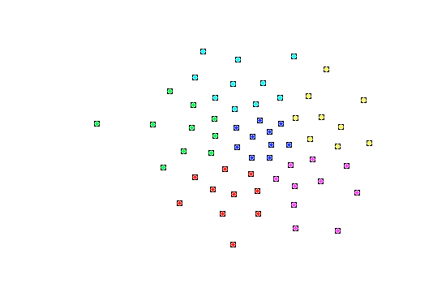
Method - Dictionaries
Description of
all patches
of subject i
K-Means with R clusters in
each parent cluster

Slide 29
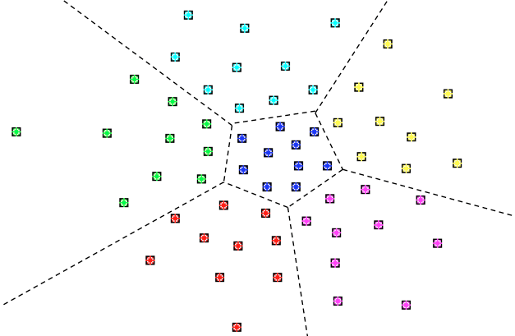
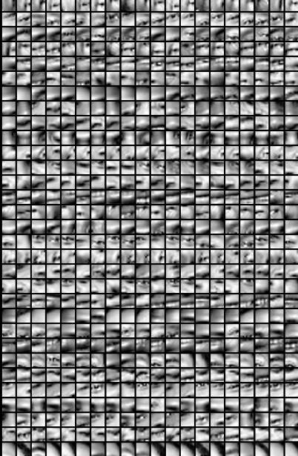
Method - Dictionaries
subject i
Q
Dictionaries
for subject i
R

Slide 30

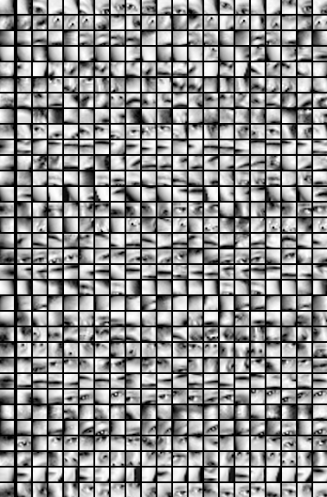
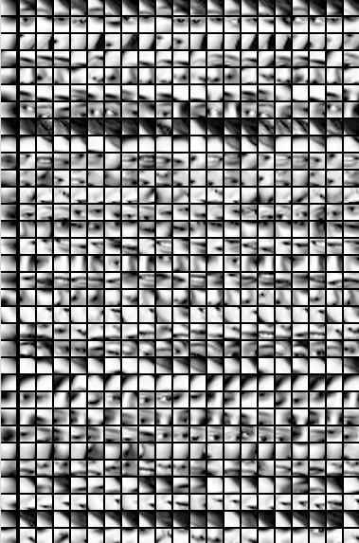
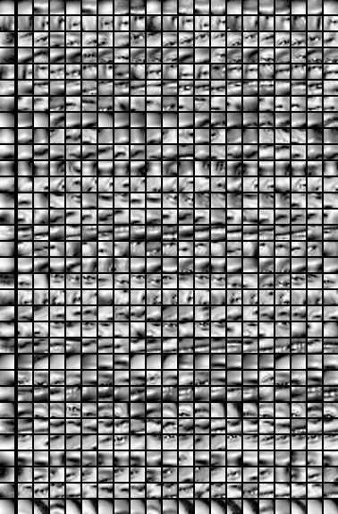
Method - Dictionaries
subject 1
Subject 2
subject i
subject k
… …

Slide 31
Method - Details
subject 1
subject i
subject k
. . . . . .
:
:
:
:
:
:
description
description
description
dictionary 1
dictionary i
dictionary k
LEARNING
TESTING
for each test patch
:
:
description
selection
of best
dictionaries
SRC
score
majority vote
query image
ID
for all test patches

Slide 32
Method - Details
subject 1
subject i
subject k
. . . . . .
:
:
:
:
:
:
description
description
description
dictionary 1
dictionary i
dictionary k
LEARNING
TESTING
for each test patch
:
:
description
selection
of best
dictionaries
SRC
score
majority vote
query image
ID
for all test patches

Slide 33

Method – Best Dictionaries
y
[patch]
[query image]
Class 2
has no match
subject 1 subject 2
subject i
subject k

Slide 34
Method – Best Dictionaries
y
[patch]
[query image]
subject 2
has no match
subject 1
subject i
subject k

Slide 35
Method – Best Dictionaries
y
[patch]
[query image]
subject 1
subject i
subject k

Slide 36
Method – Best Dictionaries
y
[patch]
[query image]
Adaptive
Dictionary
of y
subject 1
subject i
subject k

Slide 37
Method - Details
subject 1
subject i
subject k
. . . . . .
:
:
:
:
:
:
description
description
description
dictionary 1
dictionary i
dictionary k
LEARNING
TESTING
for each test patch
:
:
description
selection
of best
dictionaries
SRC
score
majority vote
query image
ID
for all test patches

Slide 38
Method - Details
subject 1
subject i
subject k
. . . . . .
:
:
:
:
:
:
description
description
description
dictionary 1
dictionary i
dictionary k
LEARNING
TESTING
for each test patch
:
:
description
selection
of best
dictionaries
SRC
score
majority vote
query image
ID
for all test patches

Slide 39
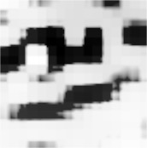

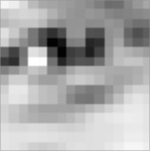
Method – Best Dictionaries
y
[patch]
[query image]
Sparse Representation
subject 1
subject i
subject k
Best Reconstruction
Best Concentration

Slide 40
Method
subject 1
subject i
subject k
. . . . . .
:
:
:
:
:
:
description
description
description
dictionary 1
dictionary i
dictionary k
LEARNING
TESTING
for each test patch
:
:
description
selection
of best
dictionaries
SRC
score
majority vote
query image
ID
for all test patches

Slide 41
Can random patches be used
to recognize any face?
Motivation
Method
Experiments
Conclusions

Slide 42
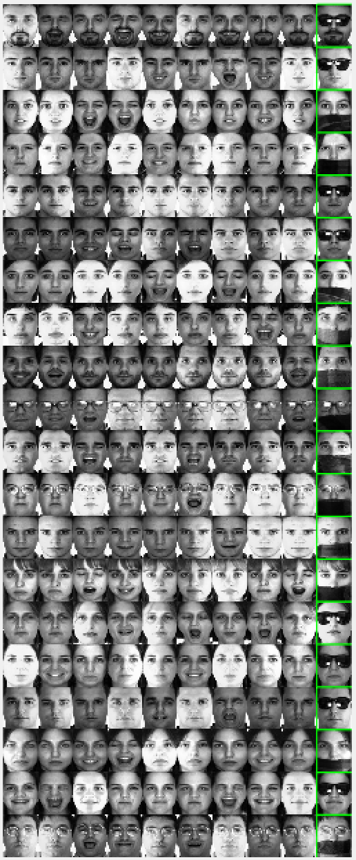
AR Database
Training
Subjects without disguise
Testing
Subjects with disguise
Notes:
clear op; op.R=40;op.Q=80;op.m2=800;op.k=20;op.n=10;op.show=3;op.alpha=1;op.stoplist=0;p=asr_main_map('ar+',op)

Slide 43
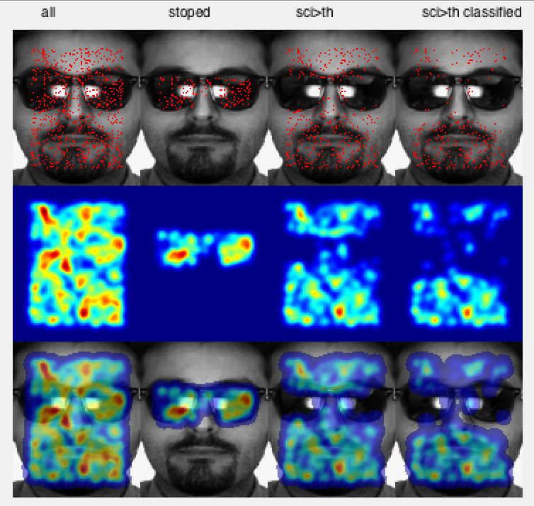
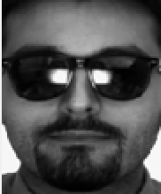
Query Image
Extracted
patches
Eliminated
patches
Classified
patches
Majority
vote
A red point represents the center of a patch
.

Slide 44

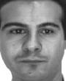
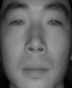
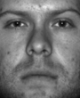
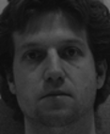
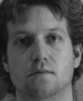
expressions
FWM
disguise
AR
VIS + NIR
CASIA
99 %
100 %
100 %
illumination
YALE
pose 15º
MPIE
pose 30º
MPIE
100 %
95 %
83 %

Slide 45
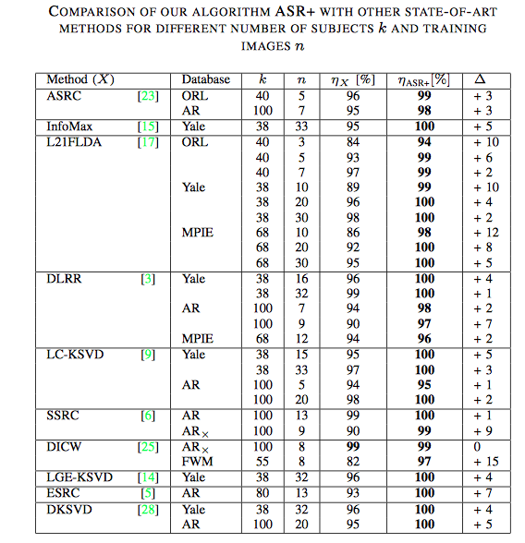

Slide 46
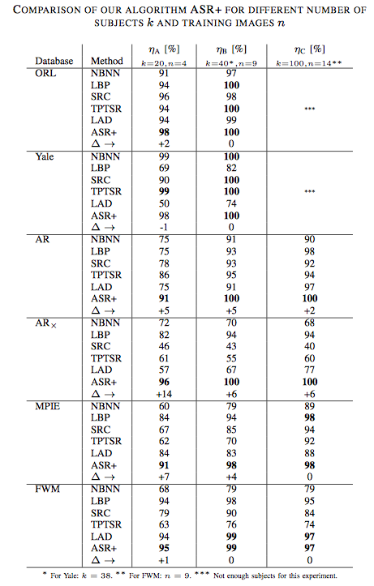

Slide 47
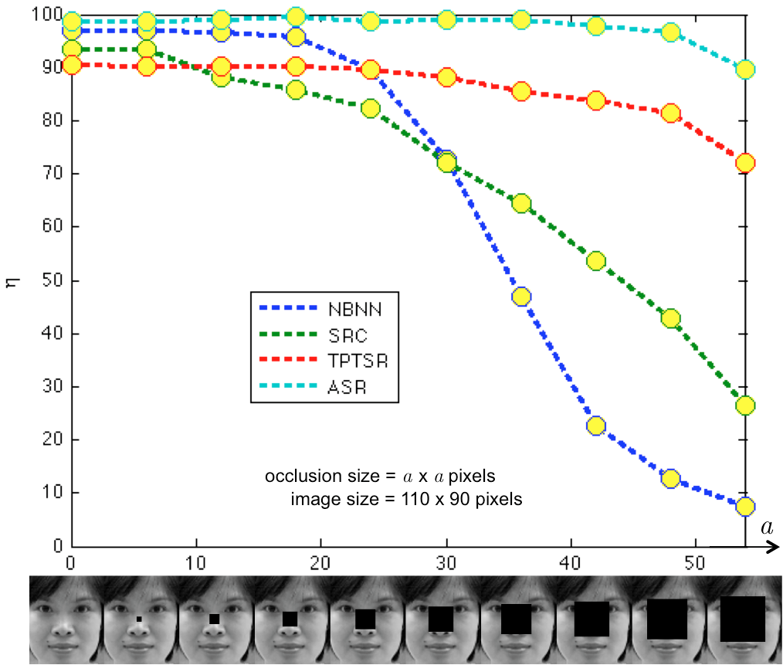

Slide 48
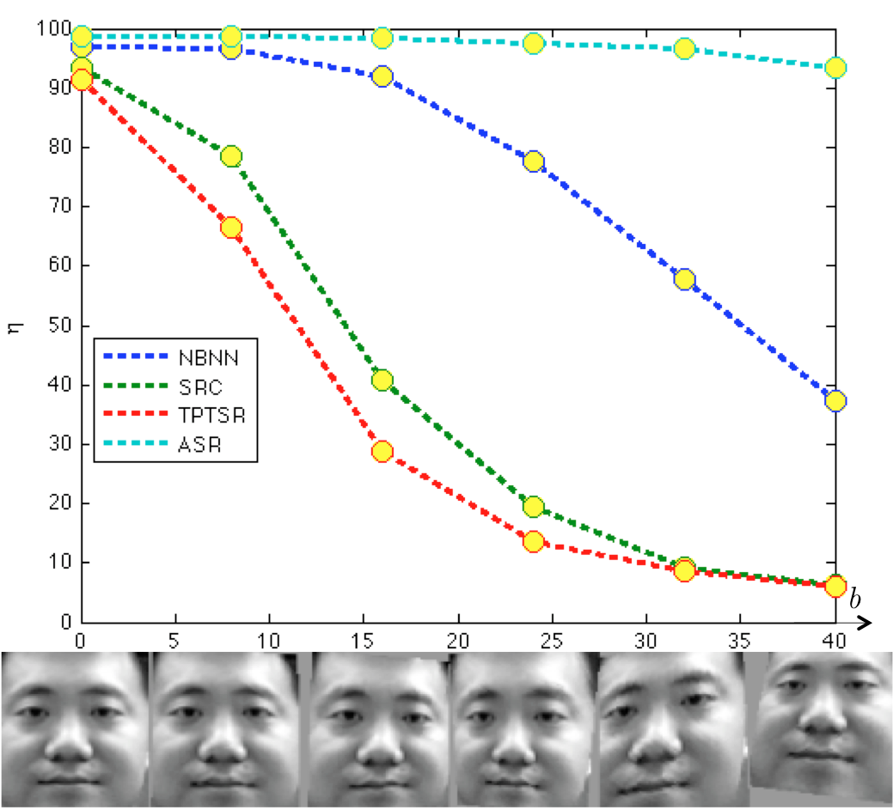

Slide 49
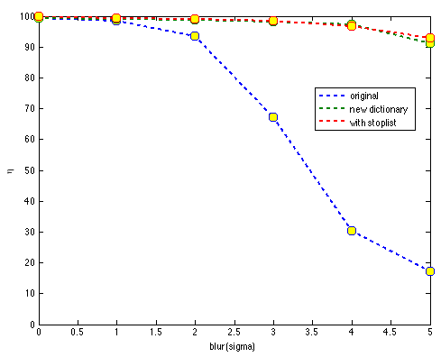
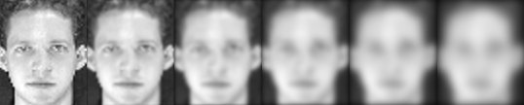

Slide 50
Recognition of Facial Attributes
(gender, expressions, age, race, etc.)

Slide 51

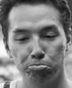
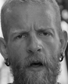
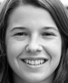
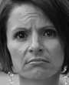
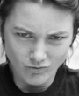
Method
class 1
class i
class k
. . . . . .
:
:
:
:
:
:
description
description
description
dictionary 1
dictionary i
dictionary k
LEARNING
TESTING
for each test patch
:
:
description
selection
of best
dictionaries
SRC
score
majority vote
query image
class
for all test patches

Slide 52
Method
class 1
class i
class k
. . . . . .
:
:
:
:
:
:
Visual Vocabulary & Stop List
description
description
description
dictionary 1
dictionary i
dictionary k
LEARNING
TESTING
for each test patch
:
:
description
selection
of best
dictionaries
SRC
score
majority vote
query image
class
for all test patches

Slide 53
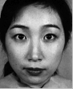
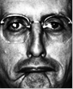
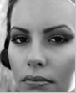
expressions
JAFFE
disguise
AR
94.3 %
97.8 %
gender
FERET
race
WEBRACE
95.0 %
87.1 %
Notes:
JAFFE: 7 classes: anger, disgust, fear, happiness, sadness, surprise and neutral (29 for training)
Disguise: 3 classes: With scarf, with sunglasses, no disguise (20 for training)
Gender: 2 classes: Female and Male (440 for training)
Race: 5 classes: Asian, black, Hispanic, Indian, White (79 for training)

Slide 54
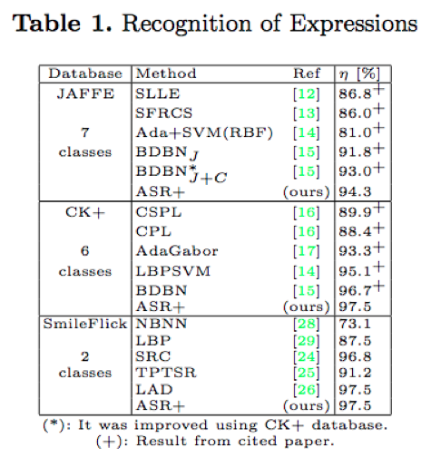

Slide 55
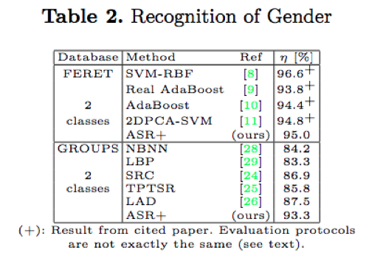

Slide 56
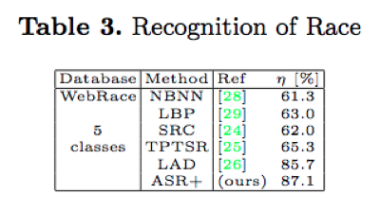

Slide 57
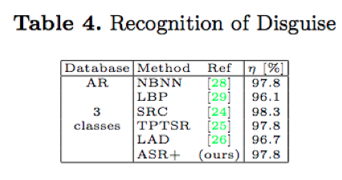

Slide 58
Can random patches be used
to recognize any face?
Motivation
Method
Experiments
Conclusions

Slide 59
Conclusions
A new algorithm based on random patches and adaptive sparse representations.
Rich collection of relevant parts
Adaptive dictionaries
Experiments have been performed in two directions:
Comparison with other known general methods
Comparison with other papers

Slide 60
Conclusions
Random patches can be used to recognize faces.
Our approach can be used in other recognition problems: e.g. gender, expression, etc.*
Matlab code available on: http://dmery.index.puc.cl > Material
* Mery, D.; Bowyer K. (2014): Recognition of Facial Attributes Using Adaptive Sparse Representations of Random Patches, Workshop on Soft Biometrics in ECCV 2014, Zurich, Sep. 7th. (Best Paper Award)

Slide 61
Can random patches be used to recognize any face?
Random patches can be used
to recognize any face
m
s
Notes:
Can random patches be used to recognize any facial attribute?

Slide 62
Face Recognition via Adaptive Sparse Representations of Random Patches
Domingo Mery – Kevin Bowyer
Notes:
Can random patches be used to recognize any facial attribute?

Slide 63
Face Recognition via Adaptive Sparse Representations of Random Patches
Domingo Mery – Kevin Bowyer
Notes:
Can random patches be used to recognize any facial attribute?

Slide 64
SRC

Slide 65
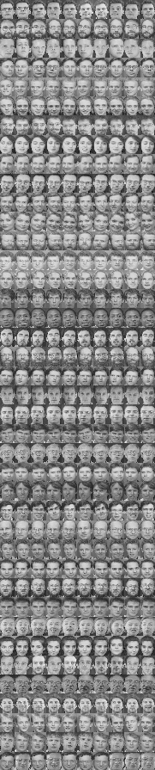
Sparse Representation Classification (SRC)
Wright, et. Al. Robust Face Recognition via Sparse Representation. PAMI 2009
In the training set there are k subjects.
For each subject we have n training images.
In this example there are 40 subjects with 9 images each.
Each image is downsampled to h x w = m pixels
Each downsampled image is represented as a vector v of m elements (by stacking its columns)
:
:
v =

Slide 66
Sparse Representation Classification (SRC)
Wright, et. Al. Robust Face Recognition via Sparse Representation. PAMI 2009
For each subject i (for i=1,…k) we have a dictionary
A_{i} = [v_{i1}, v_{i2}, …, v_{in}]
We define a new matrix A by concatenating all individual dictionaries
A = [A₁, A₂, …, A_{k}]
The size of A is m x (nk)
A is normalized (its columns have unit l² norm).

Slide 67

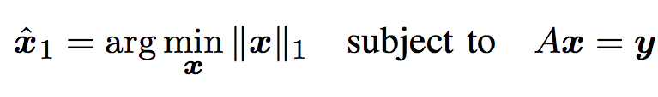
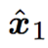
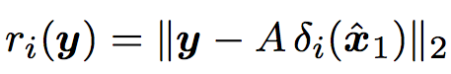
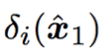
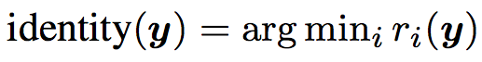
Sparse Representation Classification (SRC)
Wright, et. Al. Robust Face Recognition via Sparse Representation. PAMI 2009
How a test image is classified?
A new test image I^{t} is represented as vector y of m elements (using the same representation of the training images)
Now, we look for a sparse representation of y using l1-minimization approach:
I^{t}
We compute the residuals:
The identity of I^{t} is :
i

Slide 68
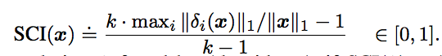
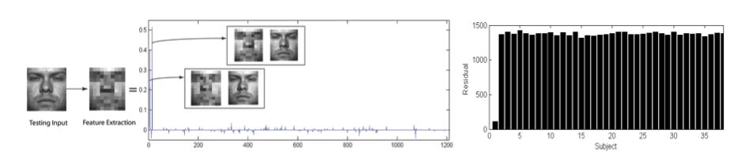
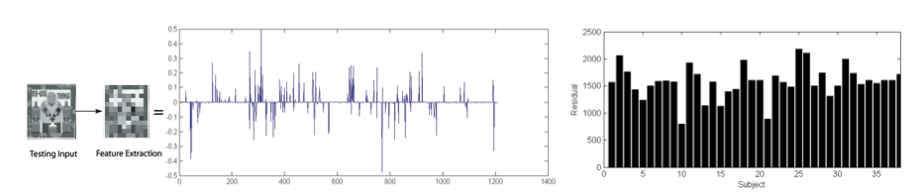
Sparse Representation Classification (SRC)
Wright, et. Al. Robust Face Recognition via Sparse Representation. PAMI 2009
How good is the classification?
We use the Sparsity Concentration Index (SCI)

